Slide 1
Power in
Electric Circuits

Slide 2
Electrical Power
Power (P) is measured in Watts (W)
True for Electricity (e.g. Light Bulbs, Toasters, etc.)
True for Mechanical (e.g. non-electric) machines
For an electric circuit:
P= VI
Where:
P is Power, Measured in Watts (W)
V is Potential Difference, Measured in Volts (V)
I is Current, Measured in Amps (A)

Slide 3
P = VI
Examples:
The current through a resistor is 0.1 A and the voltage drop across the same resistor is 1.5 V. What is the power dissipated by the resistor?
Standard household electricity is 110 V. What is the current drawn by a 60 W light bulb?

Slide 4
Electrical Power - #2
We can use Ohm’s Law to derive a second equation
Substitute using : V=IR into P=VI
For an electric circuit:
P= I²R
Where:
P is Power, Measured in Watts (W)
I is Current, Measured in Amps (A)
R is Resistance, Measured in Ohms (Ω)

Slide 5
P = I²R
Examples:
A 10 Ω resistor draws a current of 0.2 A. What is the power dissipated by the resistor.
A 1000 watt hair dryer draws a current of 5 amps. What is the resistance of the hair dryer?

Slide 6
Electrical Power - #3
We can use Ohm’s Law to derive a third equation
Substitute using : I = V/R into P=VI
For an electric circuit:
P= V²/R
Where:
P is Power, Measured in Watts (W)
V is Potential Difference, Measured in Volts (V)
R is Resistance, Measured in Ohms (Ω)

Slide 7
P = V²/R
Examples:
Clothes dryers are typically wired into a 220 V circuit. What is the resistance of a 1200 watt dryer?
If the same clothes dryer is wired into a 110 V circuit, what will its effective power be?

Slide 8
Electrical Energy
Energy is related to both Power (P) and Time(Δt)
A high power device used for a short time
A low power device used for a long time
For an electric circuit:
ΔE= PΔt
Where:
ΔE is the Energy Change
P is Power
Δt is the Time Duration
Same Energy

Slide 9
ΔE= PΔt
For Low Power Applications (e.g. Batteries)
ΔE is Measured in Joules (J)
P is Measured in Watts (W)
Δt is Measured in Seconds (s)
For High Power Applications (e.g. House)
ΔE is Measured in Kilo-Watt-Hours (kWh)
P is Measured in Kilo-Watts (kW)
Δt is Measured in Hours (h)

Slide 10
ΔE= PΔt
1 kWh (Kilo-Watt-Hours) is equal to how many Joules (J)?

Slide 11
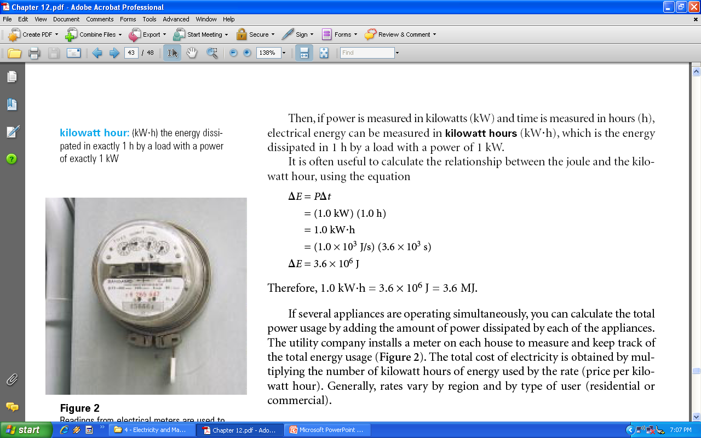
The Cost of Electricity

Slide 12
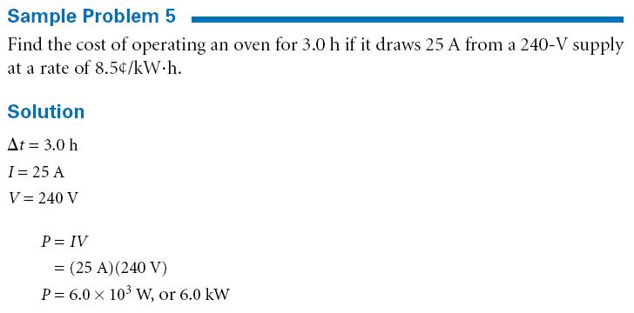
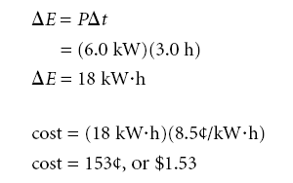

Slide 13
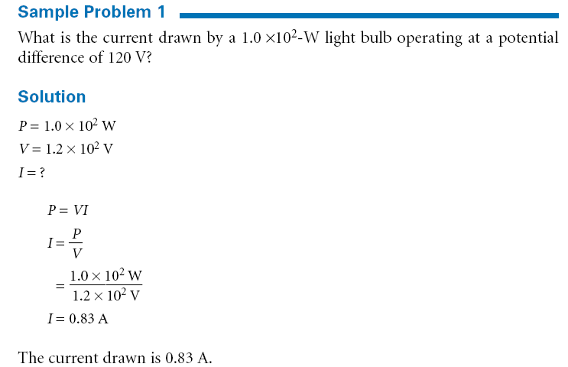

Slide 14
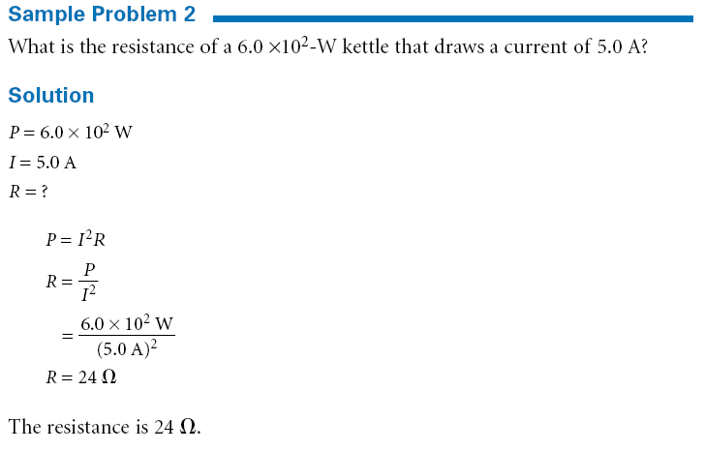

Slide 15
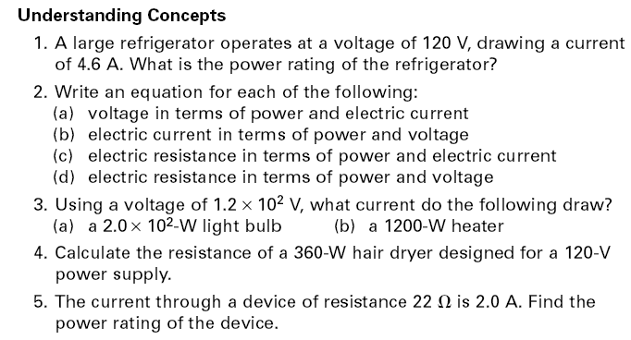

Slide 16
Problems
Page 465 #’s 6-7
Page 466 #’s 1-10

